Slide 1


TROLLEY UNION
2024 Benefits Open Enrollment
Notes:
Hi, and welcome to your overview of the 2024 benefit plans. We know your time is valuable so let’s get started!

Slide 2
2024 Plan Year: January 1st 2024 – December 31st 2024
BE PREPARED
BE INFORMED
BE INVOLVED
Mark your calendar and involve your spouse/partner
Read your enrollment information
Learn how your
benefits work
Notes:
San Diego Metropolitan Transit System’s plan year runs from January 1st through December 31st. Open Enrollment changes go into effect January 1st.
If you are a full time new hire your medical benefits go into effect on the first of the month following 60 days from your date of hire. All other benefits are effective first of the month following 180 days from your date of hire.
If you are a part time new hire your medical benefits go into effect on the first of the month following 60 days from your date of hire. Your dental and vision benefits are effective the first of the month following 21 months from your date of hire and all other benefits are effective the first of the month following 24 months from your date of hire.
Be Prepared, Be Informed, and Be Involved so that you can select the plans that will best fit your needs. This presentation provides high level benefit information. For more detailed information, refer to your benefit guide and the MyADP website for specific plan details and summaries.

Slide 3

Changing your benefits
At Open Enrollment
At other times of the year
Change medical plans
Enroll in a new plan
Add or drop dependent coverage
Enroll in the FSA
Changes are allowed within 30 days of a qualifying life event, such as:
  Change in marital status
  Newborn or adopted child
  Losing or gaining other health coverage
Notes:
You can change your benefit choices at specific times during the year.
During the Open Enrollment period you can make changes to your benefits, including: switching to a different medical plan; enrolling in a plan you’re not currently enrolled in; adding or dropping dependents, and enrolling in the healthcare and dependent care Flexible Spending Accounts.
Once Open Enrollment is over, you are not allowed to make changes to your benefits unless you have a qualifying life event like getting married or divorced, or adding a new child to your family. You have 30 days after your qualifying life event to submit any changes.

Slide 4

Who you can cover
Yourself, if you are in a benefits eligible position or work at least 30 hours per week
Spouse or registered domestic partner
Children up to age 26
Disabled tax dependents over age 26
Children named in QMCSO
*Proof of relationship (marriage/birth certificate) necessary to enroll dependents
Notes:
As a reminder -- here’s who you can cover under your medical, dental, vision and dependent eligible voluntary benefit plans:
You are eligible if you are in a benefits eligible position or work at least 30 hours per week
You can cover your spouse or registered domestic partner
You can cover your children up to age 26.
You can cover children over age 26 if they are disabled and are your tax dependents.
You can cover other children as required by court-ordered child support.

Slide 5

Medical Plans
Notes:
Let’s review your medical plan choices.

Slide 6

Medical Plans
MTS offers three medical plans to choose from through Blue Shield
  Trio HMO Plan
  Access+ Full Network HMO Plan
  PPO Plan
MTS offers one medical HMO plan through Kaiser
Notes:
San Diego MTS offers three medical plans through Blue Shield. Two HMO plans and one PPO plan. Additionally, San Diego MTS offers one HMO plan through Kaiser.
You’ll learn more about the plan features as we move through this presentation.
You can find out more about the plans, search for doctors, and create your own personal account on www.blueshieldca.com or www.kp.org.

Slide 7
Blue Shield HMO Medical Plans
 | Blue Shield HMO Full Network | Blue Shield HMO Trio Network
Plan Features | In-Network Only | In-Network Only
Annual Deductible Individual / Family | None / None | None / None
Out-of-Pocket Maximum Individual / Family | $1,500 / $3,000 | $2,500 / $5,000
Preventive Care | No copay | No copay
Office Visit (primary/specialist) | $20 copay | $20 copay
Teladoc Consultation (Blue Shield Plans Only) | $5 copay | $5 copay
Lab & X-Ray (CT/MRI/PET) | No copay No copay | No copay No copay
Inpatient Hospital | $250 copay per admit | $500 copay per admit
Outpatient Surgery | $125 copay per procedure | $250 copay per procedure
Emergency Room (waived if admitted) | $100 copay | $150 copay
Urgent Care | $20 copay | $20 copay
Chiropractic Care Acupuncture Care | $15 copay $15 copay (Combined 30 visits per year) | $15 copay $15 copay (Combined 30 visits per year)
Notes:
San Diego MTS provides you with two Blue Shield HMO plan options. The Trio HMO is a narrow network, which allows access to Scripps medical group and Mercy Physicians Group only, while the Access+ HMO includes access to all Blue Shield HMO contracted medical groups – for example, Scripps, Sharp Rees Stealy, Sharp Community, UCSD, Arch Health Partners and more.
With a Blue Shield HMO plan, you must select a primary care provider, referred to as a “PCP”. Your PCP will direct your care and any referrals needed within the medical group.
The HMO plans both have a $20 copay for a PCP and a $20 copay for a specialist. However, you will see there are differences in cost if you are hospitalized, the copay is $500 per admit on the Trio HMO, or $250 per admit on the Access+ HMO.

Slide 8
Blue Shield HMO Pharmacy Plans
 | Blue Shield HMO Full Network | Blue Shield HMO Trio Network
Prescription Drug Coverage | Express Scripts | Express Scripts
Out-of-Pocket Maximum Individual / Family | $2,500 / $5,000 | $2,500 / $5,000
Prescription Drug: Retail Generic Brand Non-Formulary Brand | (30-day supply) $10 copay $20 copay $50 copay | (30-day supply) $10 copay $20 copay $50 copay
Prescription Drug: Mail Order Generic Brand Non-Formulary Brand | (90-day supply) $20 copay $40 copay $100 copay | (90-day supply) $20 copay $40 copay $100 copay
Notes:
If you get your prescriptions at a pharmacy, the HMO plans have a $10 copay for Tier 1 generic drugs, $20 copay for Tier 2 preferred drugs and a $50 copay for Tier 3 non-preferred drugs.
You may also set up mail order for prescription drugs at 2 times the copay for a 90 day supply.

Slide 9
Blue Shield PPO Medical Plan
 | Blue Shield PPO
Plan Features | In-Network | Out-of-Network
Annual Deductible Individual / Family | $500 / $1,500 | $1,000 / $3,000
Out-of-Pocket Maximum Individual / Family | $2,000 / $4,000 | $4,000 / $8,000
Preventive Care | No copay | 30% coinsurance after deductible
Office Visit (primary/specialist) | $20 copay | 30% coinsurance after deductible
Teladoc Consultation (Blue Shield Plans Only) | $20 copay | Not covered
Lab/Radiology/Scans (CT/MRI/PET) | No copay No copay | 30% coinsurance after deductible 30% coinsurance after deductible
Inpatient Hospital | 20% coinsurance after deductible | 30% coinsurance after deductible
Outpatient Surgery | 20% coinsurance after deductible | 30% coinsurance after deductible
Emergency Room (waived if admitted) | $100 copay | $100 copay
Urgent Care | $20 copay | 30% coinsurance after deductible
Chiropractic Care Acupuncture Care | $20 copay $20 copay | 30% coinsurance after deductible 30% coinsurance after deductible
 | (Combined 30 visits per year)
Notes:
San Diego MTS also provides a Blue Shield PPO plan option.
A PPO plan allows you the freedom to see any provider you choose. You will pay less out of pocket if you see a Blue Shield in-network contracted provider.
The PPO plan has an in-network deductible of $500 for an individual and $1,500 for a family. This plan has an embedded deductible, which means that even if you’re enrolled as a family, an individual will only need to satisfy the individual deductible before the plan begins paying for services for that individual.
On this PPO plan, there is a $20 copay for a PCP and a $20 copay for a specialist. If you are hospitalized, you pay an in-network co-insurance of 20% after your deductible.

Slide 10
Blue Shield PPO Pharmacy Plan
 | Blue Shield PPO
Prescription Drug Coverage | Express Scripts In-Network Out-of-Network
Out-of-Pocket Maximum Individual / Family | $5,850 / $10,700
Prescription Drug: Retail Generic Brand Non-Formulary Brand | (30-day supply) $10 copay $20 copay $35 copay | Not covered
Prescription Drug: Mail Order Generic Brand Non-Formulary Brand | (90-day supply) $20 copay $40 copay $70 copay | Not covered
Prescriptions are only covered through a contracted pharmacy. There is no out of network coverage.
Notes:
If you get your prescriptions at an in-network pharmacy, the PPO plan has a $10 copay for Tier 1 generic drugs, $20 copay for Tier 2 preferred drugs and a $35 copay for Tier 3 non-preferred drugs.
You may also set up mail order for prescription drugs at 2 times the cost for a 90-day supply.
Prescriptions are only covered through a contracted pharmacy. There is no out of network prescription coverage.

Slide 11
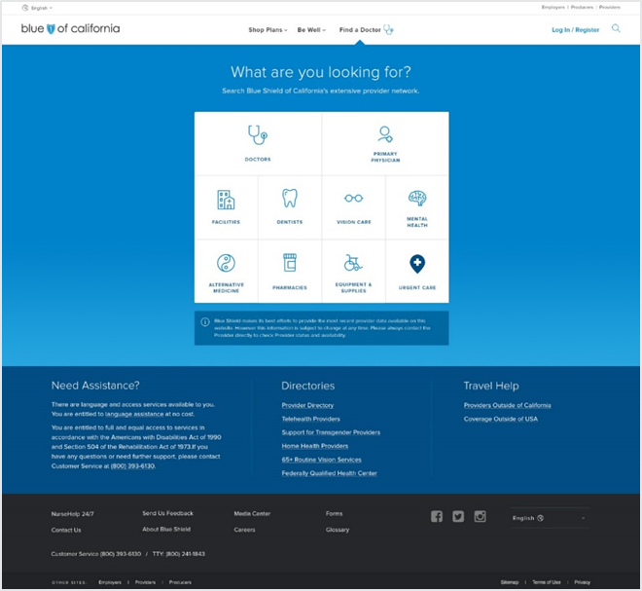
Blue Shield – Find a doctor
You can search for a participating physician by:
Gender
Specialty
Language preference
Location
Create and download your own custom directory
Be sure to select your specific plan choice or utilize
the following links:
Trio HMO plan: Go to blueshieldca.com/networktriohmo
Access+ Full Network HMO® plan: Go to blueshieldca.com/networkhmo
PPO plan: Go to blueshieldca.com/networkppo
Notes:
You can search for an in-network doctor on Blue Shield’s website. You can search by gender, specialty, language and/or location. Each plan has a different network, so be sure to use the correct link. You can also refer to your benefit guide for the links.

Slide 12
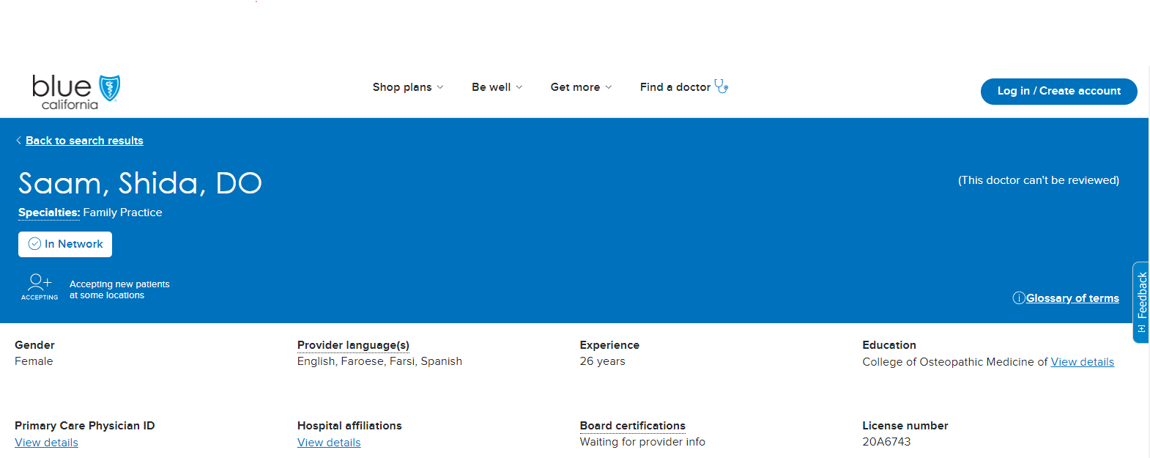
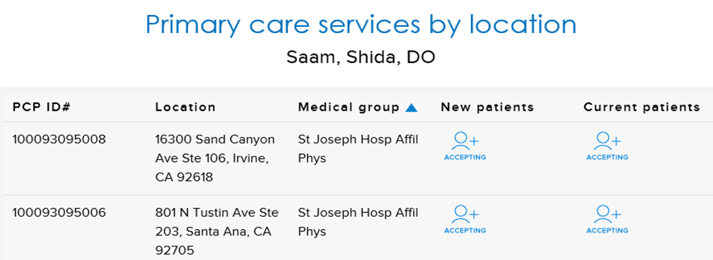
Blue Shield HMO - Your PCP
Primary care physician information is required for Blue Shield HMO plans.
Primary care physician name
To find primary care Provider ID, click here
Medical Group name(s)
PCP ID#
NOTE: All HMO participants must provide the above information when enrolling to ensure you are placed with your desired PCP. You will need to enter the PCP’s name and ID# when enrolling.
Notes:
You must select a PCP for you and any enrolled dependents when you enroll in the Blue Shield HMO plans. You and your dependents may all have different PCPs. Make sure you enter the PCP’s name and ID# when enrolling so you will be assigned to your desired doctor. This is a snap shot of Blue Shield’s website and where you can locate the PCP ID# you will need.

Slide 13

Health Reimbursement Arrangement (HRA)
If you enroll in the PPO medical plan, you have access to a Health Reimbursement Arrangement (HRA)
Administrator: Navia
Notes:
A Health Reimbursement Arrangement (HRA) is a tax-free account that you can use to pay for healthcare expenses like your deductible or coinsurance. This tax-free account is 100% funded by San Diego MTS and costs you nothing. If you enroll in the PPO plan, you will be automatically enrolled and have access to the HRA through Navia.

Slide 14
HRA Contribution
Coverage Level | HRA Contribution
Employee | $1,000.00
Employee & Spouse | $2,000.00
Employee & Child(ren) | $2,000.00
Employee & Family | $3,000.00
Notes:
Your HRA provides “first dollar coverage” for expenses — this means your HRA will reimburse you for medical and prescription drug expenses. The employer contributions are shown here and all HRA funds are available for use on the first day of coverage. Employer contributions will be prorated if you enroll after January 1st.

Slide 15



HRA features
Pay for healthcare expenses with a company-paid
Health Reimbursement Arrangement (HRA)
MTS funds HRA—
FREE HEALTHCARE DOLLARS!
Cover your deductible and other healthcare expenses—
tax-free!
Unused HRA balance
rolls over to next year.
Notes:
The HRA can substantially reduce your healthcare costs in a number of ways.
You can use the company’s contribution to pay for your deductible and other eligible healthcare expenses. On top of that, the money is completely tax-free.
Your unused balance rolls over to the next year, as long as you continue to work for San Diego MTS and continue to be enrolled in a PPO Plan.
If you leave the company, you can’t take your balance with you. Special considerations may be made upon retirement.

Slide 16
Kaiser HMO Plan
 | Kaiser HMO
Plan Features | In-Network Only
Annual Deductible Individual / Family | None / None
Out-of-Pocket Maximum Individual / Family | $1,500 / $3,000
Preventive Care | No copay
Office Visit (primary/specialist) | $20 copay
Teladoc Consultation (Blue Shield Plans Only) | Contact Kaiser for telemedicine service options/costs
Lab & X-Ray (CT/MRI/PET) | No copay No copay
Inpatient Hospital | $250 copay per admit
Outpatient Surgery | $125 copay per procedure
Emergency Room (waived if admitted) | $100 copay
Urgent Care | $20 copay
Chiropractic Care Acupuncture Care | $15 copay $15 copay (Combined 30 visits per year)
Notes:
In addition to the two Blue Shield HMO plans, San Diego MTS provides you with a Kaiser Permanente medical HMO plan.
With this HMO plan, you must select a primary care provider, referred to as a “PCP” directly with Kaiser after you enroll. Your PCP will direct your care and any referrals needed within Kaiser.
The plan has a $20 copay for a PCP and a $20 copay for a specialist. If you are hospitalized, there is a $250 copay per admit.

Slide 17
Kaiser HMO Pharmacy Plan
 | Kaiser HMO
Prescription Drug Coverage
Out-of-Pocket Maximum Individual / Family | Combined with Medical
Prescription Drug: Retail Generic Brand Non-Formulary Brand | (30-day supply) $10 copay $20 copay $20 copay
Prescription Drug: Mail Order Generic Brand Non-Formulary Brand | (100-day supply) $20 copay $40 copay $40 copay
Notes:
When you obtain your prescriptions at a Kaiser pharmacy, the HMO plan has a $10 copay for Tier 1 generic drugs and $20 copay for Tier 2 preferred drugs.
You may also set up mail order for prescription drugs at 2 times the copay for a 100 day supply.

Slide 18
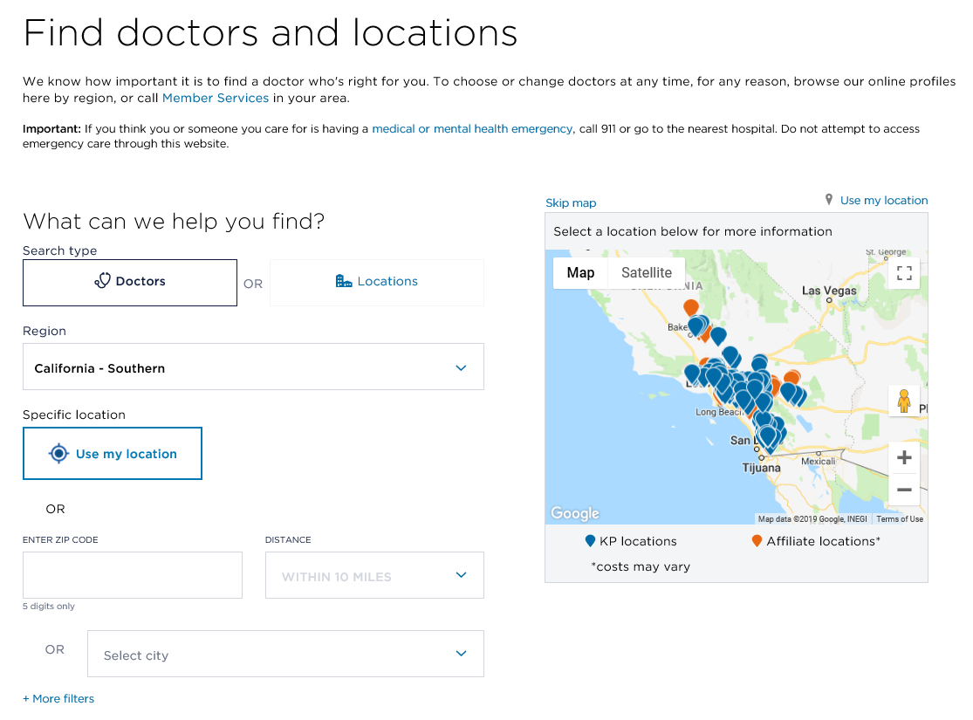
Kaiser – Find a doctor
Visit www.kp.org and click on “Doctors and Locations”
Select Southern California
Choose the Location and Provider Type
Click “Search”
Under Health Plan, Select “HMO”
You can further filter your search for a participating
physician by:
Gender
Specialty
Language preference
Location
https://healthy.kaiserpermanente.org/southern-california/doctors-locations#/search-form
Notes:
You can search for an Kaiser provider on the Kaiser website, www.kp.org. You can search by gender, specialty, language and/or location.

Slide 19

Preventive vs. diagnostic care
Both can include physical exams, lab tests, immunizations and prescriptions
PREVENTIVE
Helps you stay healthy by checking for disease before you feel sick
FREE when obtained
in-network
DIAGNOSTIC
Checks for disease after you have symptoms or because of a known health issue
Subject to deductible, copays & coinsurance
EXAMPLES
Annual physicals
Well woman exams & mammograms
Childhood & recommended adult immunizations
Visit healthcare.gov for complete list
EXAMPLES
Sick office visits
Mammogram due to a lump
Travel immunizations
Blood pressure medicine
Full body scans
Other health issues
Notes:
Each of our plans fully cover in-network preventive care. That includes your annual physical exam, well baby care, well woman care, certain routine tests for men and women, and recommended immunizations. Getting an annual checkup helps you set a baseline for your health and can identify health issues before they become serious.
PREVENTIVE CARE checks for disease before you feel sick. It can include physical exams, lab tests, immunizations and prescriptions. You don’t have to pay any out-of-pocket costs for preventive care, as long as it is provided by an in-network provider. Preventive care can help you and your doctor identify problems early before they become serious.
DIAGNOSTIC CARE may also include physical exams, lab tests, immunizations or prescriptions. Services are considered diagnostic care if they are provided to treat a known health issue or to check out symptoms you may be having. When a service is classified as diagnostic care, you will be responsible for paying the deductible, copay or coinsurance.
Both types of care are important for maintaining your health. Understanding the difference will help you avoid surprises around the cost of care.

Slide 20
Get more from the Blue Shield plans!
LifeReferrals 24/7
NurseHelp 24/7
Teladoc 24/7
Website & app
Personal issues
Financial questions
ID Theft
(800) 985-2405
lifereferrals.com
Benefits information
Claims and account balances
blueshieldca.com
Free advice 24/7
Medical professional
(877) 304 0504
blueshieldca.com/nursehelp
Virtual Dr. visit
Prescriptions
No appointments
(800) 835-2362
teladoc.com/bsc
teladoc.com/mobile
Notes:
Take advantage of all the free or low cost services that are available to help you stay or get well.
LifeReferrals 24/7 offers convenient support to help you meet life’s challenges. A simple phone call connects you with a team of experienced professionals ready to assist you with a wide range of personal, family and work issues. You can call LifeReferrals 24/7 toll-free, anytime, at (800) 985-2405. You can also find more information online by going to www.lifereferrals.com and entering the access code: bsc.
Creating an account on Blue Shield’s website can make managing your healthcare much more convenient. You can get access to your individual benefits information, such as how much of your deductible you’ve met and your claims details. Your plan also has an app, allowing you to get the same information on the go. From your phone, download the Blue Shield of California mobile app via the App Store or Google Play and click register.
Your health plan has a free 24 hour NurseHelp line you can call to speak with a medical professional who can provide home care tips or advise you on next steps in care. Call (877) 304-0504 to talk to a nurse, day or night, or visit blueshieldca.com/nursehelp for an online chat option.
Teladoc lets you arrange a virtual visit through your smart phone, tablet or computer, wherever you are at any time of day or night. You don’t need an appointment. This service is for minor illnesses and injuries. Don’t use this service if you have a serious condition or a life threatening emergency. Visit www.teladoc.com/bsc or www.teladoc.com/mobile and complete the required information to set up your account. You can also call Teladoc at (800) 835-2362 for help.

Slide 21

Wellness
Notes:
Blue Shield and Kaiser both offer access to many wellness programs, challenges, and health-related information to their members.

Slide 22
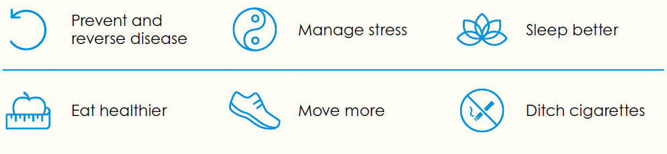
Blue Shield’s Wellvolution Features
Online and In-person programs
Scientifically backed apps
Personal health coaches
New strategies to achieve health goals
Focus and track progress
Supportive reminders, motivation, and engagement
Results backed by science and real positive changes
Visit wellvolution.com to get started on your personal proven path.
Blue Shield’s Wellvolution is available to HMO members.
Notes:
Tap into decades of research and leading technology for a more productive and healthy lifestyle with Blue Shield’s wellness program - Wellvolution.
Wellvolution offers the largest curated collection of scientifically-backed apps and programs designed to help you: prevent and reverse disease, sleep better, ditch cigarettes and more!
To discover your proven path, visit wellvolution.com.

Slide 23
Kaiser Wellness Features
Good health goes beyond the doctor’s office. Here are some of the tools available.
Health classes—Choose from a large variety of classes and support groups offered at our facilities.*
Healthy lifestyle programs—Our online programs can help you lose weight, reduce stress, quit smoking, sleep better, and more—at no cost to members.
Wellness coaching—Call our wellness coaches at 1-866-862-4295. They will work one-on-one with you by phone at no cost to members—and no referrals needed.
Reduced rates for members—Visit kp.org/choosehealthy for special rates on a variety of products and services, like gym memberships and massage therapy through ChooseHealthy.^{TM†}
Online wellness tools—Visit kp.org/healthyliving for helpful articles, wellness information, health calculators, podcasts, and more.
Say hello to better health
Notes:
Explore healthy resources available through Kaiser. Take advantage of these extra perks – from personal health coaching to discounts on alternative medical therapies.

Slide 24

Dental and Vision
Notes:
In addition to our medical plans, you have access to dental and vision benefits.
Don’t forget that you can use a healthcare Flexible Spending Account to pay for dental and vision expenses.

Slide 25
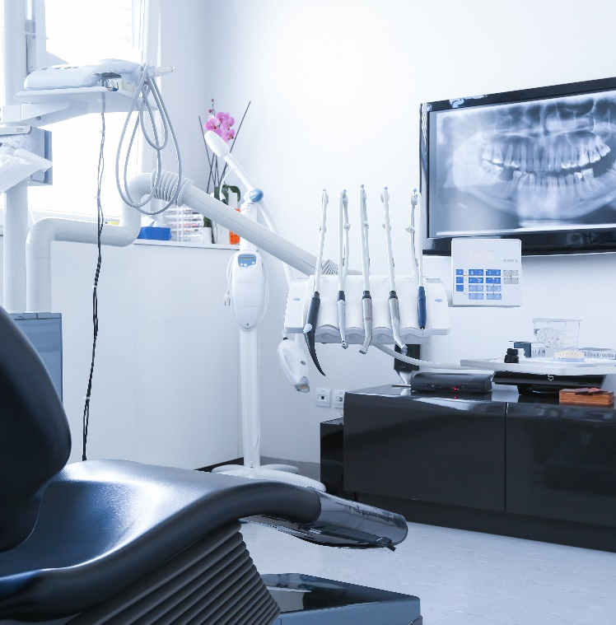
Dental Plans
MTS offers two PPO dental plans through MetLife
  Low PPO Plan
  High PPO Plan
Access to the MetLife PDP Plus Network of providers available at www.metlife.com/dental
ID cards are not issued or needed, provider will confirm coverage directly with MetLife
You may also receive services from providers outside of the network; however, you will pay more out-of-pocket
Notes:
San Diego MTS offers two PPO dental plans through MetLife. You will have access to in network providers with MetLife’s PDP Plus Network. You can look up in network providers at www.metlife.com/dental.
MetLife is a paperless provider so ID cards are not issued. Simply advise your provider that you have MetLife coverage and they will access your policy (and your dependents’, if covered) with your name and Social Security Number.

Slide 26
Dental Plans
Low Dental PPO Plan |  |  | High Dental PPO Plan
Plan Features | In-Network | Out-of-Network | In-Network | Out-of-Network
Deductible Individual / Family | None / None | $25 / $75 | $50 / $150
Calendar Year Benefit Maximum | $1,000 |  | $2,500
Member Pays
Preventive — Class I Oral exam, Routine cleaning, & X-rays | 0% | 0%; deductible waived | 0%; deductible waived | 0%; deductible waived
Basic — Class II Fillings, Extractions, Endodontics, Periodontics | 20% | 20% after deductible | 10% after deductible | 20% after deductible
Major — Class III Crowns, Dentures, Bridges | 50% | 50% after deductible | 25% after deductible | 30% after deductible
Orthodontia Services | Not covered |  | 40%; deductible waived | 50% deductible waived
Orthodontia Lifetime Maximum |  |  | $2,500
Notes:
Here is a look at the two MetLife PPO dental plan options. Preventive services are fully covered with no cost to you under both plans. The High Plan will pay up to the $2,500 annual maximum in benefits, while the Low Plan has a maximum of $1,000. The High Plan also requires participants to pay a smaller percentage of Basic and Major service costs than the Low Plan, after the deductible, and provides an Orthodontia benefit.
With a PPO Dental plan you can go to any dentist of your choice. Staying in-network and seeing a dentist that is contracted with MetLife’s PDP Plus Network will help keep your out of pocket costs down.
Visit www.metlife.com/dental to find participating dental providers.

Slide 27

Vision Plan
MTS offers a vision plan through MetLife
The vision plan has in network and out of network benefits
Look for an in network MetLife vision provider at www.metlife.com/vision
ID cards are not issued or needed, provider will confirm coverage directly with MetLife
Staying in network with a contracted provider will lower your out of pocket cost
Notes:
San Diego MTS offers a PPO vision plan through MetLife. You will have access to in network providers contracted with MetLife. You can look up in network providers at www.metlife.com/vision.
MetLife is a paperless provider so ID cards are not issued. Simply advise your provider that you have MetLife coverage and they will access your policy (and your dependents’, if covered) with your name and Social Security Number.

Slide 28
Vision Plan
 |  | Vision PPO Plan
Plan Features |  | In-Network Member Allowance | Out-Of-Network Member Reimbursement
Exam Schedule |  | Once Every 12 months
Exam |  | No copay | Up to $45
Standard Lens Schedule |  | Once Every 24 months
Single Vision |  | No copay | Up to $30
Bifocal |  | No copay | Up to $50
Trifocal |  | No copay | Up to $65
Lenticular |  | No copay | Up to $100
Frame Schedule |  | Once Every 24 months
Frame Frame at Costco, Walmart & Sam’s Club |  | Up to $200; then 20% off any remaining balance Up to $110 allowance | Up to $70
Contacts Lens Schedule (In lieu of eyeglasses) |  | Once Every 24 months
Necessary Elective |  | No copay Up to $200 | Up to $210 Up to $105
Notes:
Here is a look at the MetLife PPO vision plan.
With a PPO vision plan, you will have access to in network providers. If you see an in network provider your benefit dollars will go further. With in network providers, you will have no copays for certain services. An in network provider will submit a claim directly to MetLife on your behalf. You can look up in network providers at www.metlife.com/vision.
With a PPO vision plan you still have the ability to see any vision provider you choose. If you seek services from an out of network provider, you will be subject to a reimbursement allowance. Out of network reimbursement allowances only reimburse you for a small amount, so we encourage you to stay in network. When seeking coverage out of network you may be required to submit a claim to MetLife for reimbursement.

Slide 29

Life and AD&D Plans
Notes:
No one likes to think about a serious accident or illness, but it can happen at any age. Being prepared is the best way to ensure that you and your family will be able to preserve savings and pay for day-to-day living if something happens. Let’s review the plans that are available to help you be prepared.

Slide 30

Lincoln Life and AD&D Insurance
YOU CAN PURCHASE
MTS PROVIDES:
Life & AD&D $50,000 Full Time $25,000 Part Time
FOR YOURSELF:
Life coverage up to 7x your annual earnings or $500,000
FOR SPOUSE:
Life coverage up to 100% of your coverage
FOR CHILDREN:
Life coverage up to $10,000 per child
Notes:
San Diego MTS pays for Basic Life and Accidental Death & Dismemberment insurance coverage through Lincoln. Your coverage is a $50,000 benefit for full time employees and a $25,000 benefit for part time employees.
You also have the option to purchase additional Life insurance coverage for yourself and your dependents through Lincoln. You pay the full cost of this coverage. Your cost will be calculated when you enroll. Depending on the amount you apply for, medical information may be requested by Lincoln prior to approval.

Slide 31
Lincoln Value Added Programs
LifeKeys
No matter how well you plan, unexpected challenges arise. When they do, help and support are nearby.
FuneralPrep
With many details to manage and decisions to make, the funeral planning process can be overwhelming. To help you every step of the way, we provide comprehensive planning services.
TravelConnect
Services offer security and reassurance — helping make travel less stressful. You and your loved ones can count on services 24 hours a day, 7 days a week.
Notes:
Lincoln provides additional value-added benefits. Life Keys provides support for beneficiaries following a loss as well as help with other important life matters including legal and financial advice. Funeral Prep is an online portal that provides resources and assistance with at-need-planning and pre-planning. Travel Connect can assist with trip planning and emergencies during travel.

Slide 32

Flexible Spending Account (FSA)
Administrator: Navia
Notes:
Healthcare can be expensive, but you have access to another tool to help you pay for expenses and save on taxes too. It’s called a Flexible Spending Account or FSA. Navia is the administrator for the FSA plan year.

Slide 33

Healthcare Flexible Spending Account (FSA)
FEATURES
TYPES
Up to the IRS maximum per year
Pre-tax payroll deductions
Tax-free withdrawals
Elected contribution available on the first day of coverage
USE IT OR LOSE IT!
Administered by Navia
Notes:
Do you wear glasses or contacts? Do you need a lot of expensive dental work? Do you have regular chiropractic or acupuncture visits? The healthcare FSA is perfect for these kinds of expenses. Our Healthcare FSA, through Navia, allows you to set aside money pre-tax to pay for things like medical copays, prescriptions, and other out-of-pocket expenses, as well as dental and vision expenses. Because you are paying with pre-tax dollars, it’s like an automatic 15-20% savings, or more depending on your tax bracket.

Slide 34

Dependent Care Flexible Spending Account (FSA)
Daycare and in-home care while you work, for children under 13 and incapacitated adult tax-dependents
Up to the IRS maximum per year Pre-tax payroll deductions Tax-free withdrawals Get reimbursed up to current balance USE IT OR LOSE IT
Administered by Navia
Notes:
For those of you with children under 13, you know how expensive daycare can be. The Dependent Care FSA helps you save on those unavoidable expenses.
You can set aside up to IRS determined maximum per household per year, pre-tax, to pay for daycare expenses that make it possible for you to work, including preschool, summer day camp, before or after school programs, and child or adult daycare.
This account is “use it or lose it” so plan your expenses carefully.
Generally speaking, you need to choose between participating in the dependent care FSA or claiming the federal childcare tax credit. Talk to a tax advisor or visit the IRS website to help determine which is the better choice for you.

Slide 35

Employee Assistance Program (EAP)
STRESS
FAMILY RELATIONSHIPS
WORK ISSUES
SUBSTANCE ABUSE
Aetna
800-342-8111
AGING PARENTS
FINANCIAL/
LEGAL ISSUES
24-hour telephone assistance
Up to 8 face-to-face or video confidential counseling sessions
Online assistance at resourcesforliving.com
Company Code: SDMTS
Notes:
Our focus on wellbeing includes the Employee Assistance Program through Aetna. Sometimes life throws you a curveball or is just a little more complicated than usual. The EAP can lend a helping hand in referring you to services you need.
All employees are automatically eligible on their first day of employment. The EAP entitles you and your household members to no cost, short-term counseling services as well as access to an informational website at resourcesforliving.com.
This service is entirely confidential.

Slide 36

Next Steps
Notes:
That just about wraps everything up. Next we’ll talk about what you need to do.

Slide 37
Here’s a brief outline of what’s next:
NEXT STEPS
Consider your benefit needs for the 2024 Plan Year
Review the benefit materials
Complete your enrollment online via the MyADP website from any computer at https://my.adp.com
If you want FSA benefits in 2024, you MUST make elections during the Open Enrollment period. Your current FSA election will NOT carry over to 2024.
Medical, dental, vision and life insurance will carry over
Contact HR with any questions
Notes:
Here’s a look at your next steps.
Consider your benefit needs for the 2024 plan year. Review the benefit materials and complete your benefits enrollment online at my.adp.com.
All benefits other than FSA benefits will roll over, though we encourage employees to review their elections and save and/or print an updated confirmation statement for their records during this window.
If you want FSA benefits for 2024, you MUST make elections during the Open Enrollment period. Your current FSA elections will NOT carry over to 2024.
For more detailed information on any of the available plans, refer to your benefit guide, the MyADP website, or reach out to HR for specific plan details and summaries.

Slide 38

Thanks for your time!
Notes:
Thank you for your time!

